Slide 1
BME Department Analysis
Option A
Pranav Anthapu, Rishika Jindal

Slide 2
Purpose
Keep a database of student and professor names and what track they might want to learn or teach and find statistics on student:teacher ratio, or just the number of students in each track, and find the average number of BME students per year

Slide 3
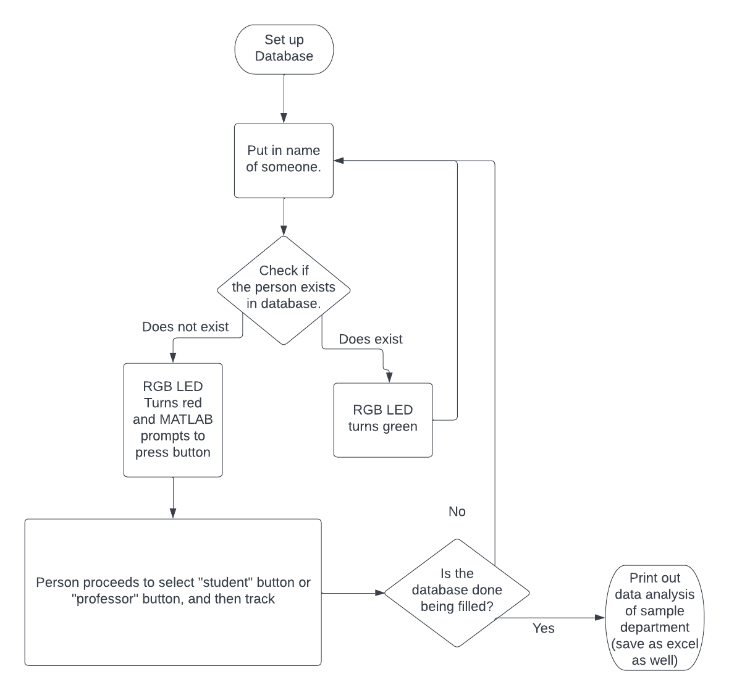
Flowchart

Slide 4
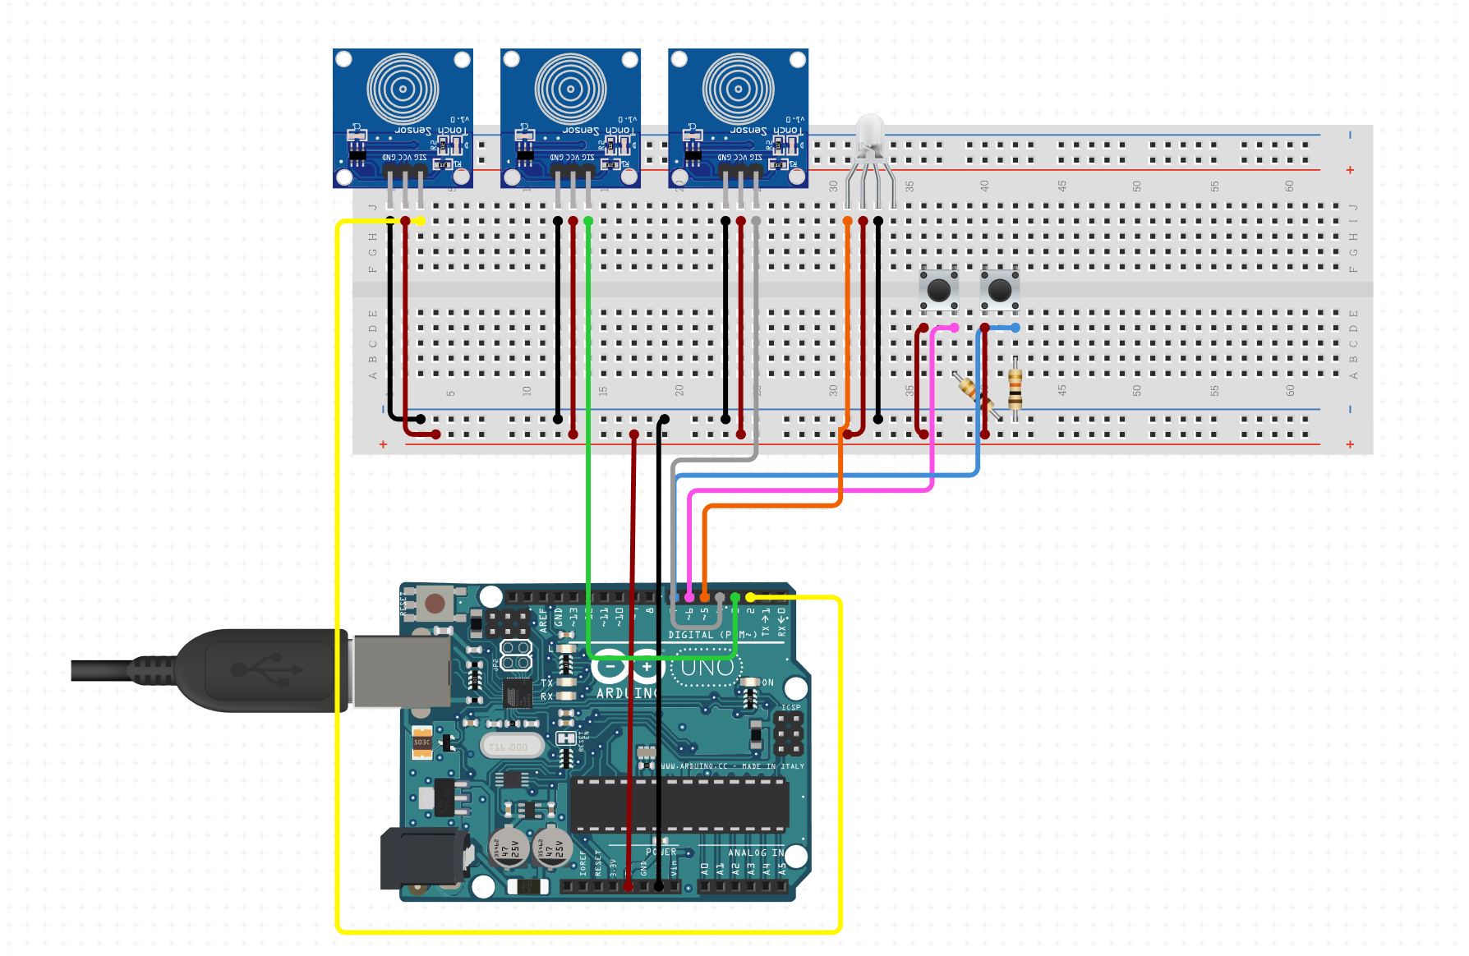
Circuit Design

Slide 5

Video

Slide 6
Challenges

Slide 7
Future thoughts/directions

Slide 8
Software
MATLAB
Involves using graph database to store data and do analysis either on the spot or at a later date
Neo4j Graph Database, specifically - to actually store data and do the data analysis *uses a separate software than just matlab but still works directly with matlab*

Slide 9
Code Outline
Load some sample data 2-3 days in advance
At time of demo, simply start the database and then use Arduino + MATLAB to input, perhaps, another 2-3 invented people
Find analytics of the made-up department, using Cypher commands in Arduino

